Slide 1

BIOMETRIC ATTENDANCE SYSTEM

Slide 2

PROBLEM STATEMENT
Traditional attendance systems, such as manual registers and RFID cards, are prone to issues like proxy attendance, loss of records, and inefficiency. A biometric attendance system eliminates these problems by using fingerprint recognition to ensure accurate, secure, and automated attendance tracking.

Slide 3
ABSTRACT
This project focuses on designing a fingerprint-based biometric attendance system using an Arduino and a fingerprint sensor. The system ensures secure and reliable attendance logging by uniquely identifying individuals based on their fingerprints. Data is displayed on an LCD screen and stored for future use. Potential enhancements include cloud integration, real-time monitoring, and multi-modal authentication.

Slide 4
INTRODUCTION
The biometric attendance system is a secure and automated solution that uses fingerprint recognition for identity verification. It eliminates manual errors, reduces proxy attendance, and provides an efficient attendance-tracking method for schools, offices, and organizations. The system consists of an Arduino microcontroller, a fingerprint sensor, an LCD display, and a storage module.

Slide 5
KEY FEATURE
Biometric Authentication – Uses fingerprint scanning for secure attendance.
Arduino-Based System – Efficient control using an Arduino microcontroller.
LCD Display – Displays attendance status and user details.
Buzzer & LED Indicators – Provides feedback for successful and failed authentication.
Data Storage – Saves attendance records for further analysis.
Proxy Prevention – Eliminates fake attendance and enhances security.
Expandable System – Can be integrated with Wi-Fi, cloud, or RFID for future enhancements.

Slide 6
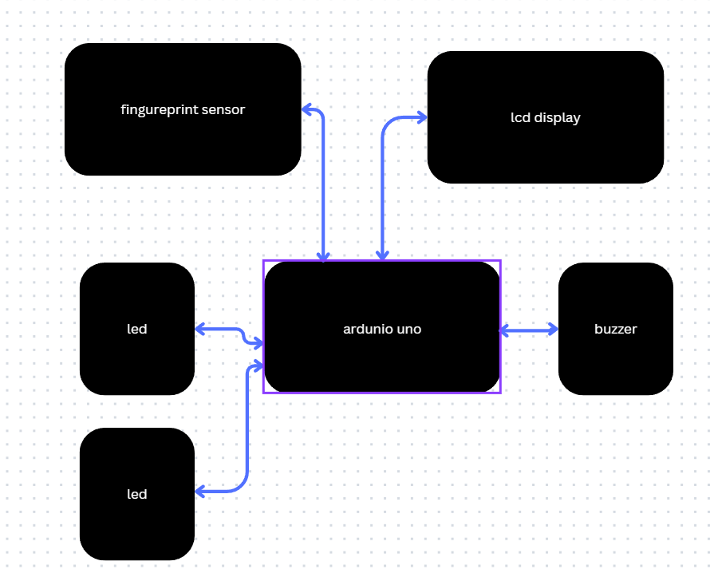
BLOCK DIAGRAM

Slide 7
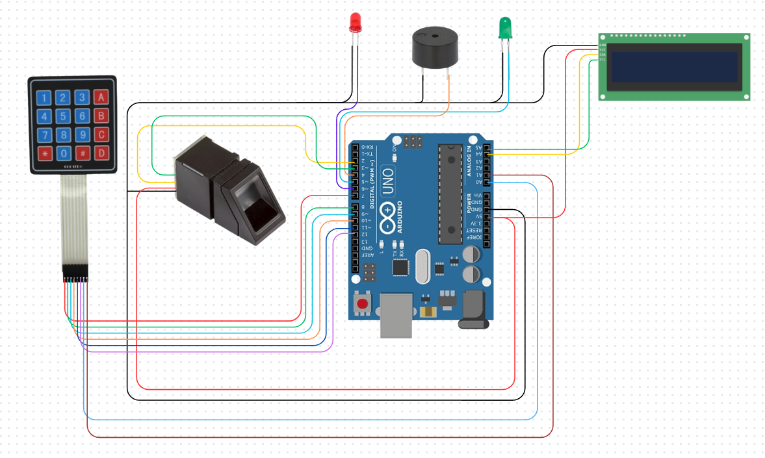
CIRCUIT DIAGRAM

Slide 8
USE CASE
Educational Institutions – Automated attendance tracking in schools and colleges.
Corporate Offices – Secure employee attendance monitoring.
Factories & Industries – Efficient workforce tracking and shift management.
Healthcare & Hospitals – Access control and staff attendance verification.
Government & Security Agencies – Enhancing identity verification and security.

Slide 9
OUTCOME
Automated Attendance – Eliminates manual processes and improves accuracy.
Secure Identification – Uses biometric authentication to prevent fraud.
Real-Time Monitoring – Instant attendance logging with quick verification.
Data Logging – Stores attendance records for future reference.
Scalability – Easily expandable with IoT, Wi-Fi, or cloud integration.

Slide 10
CONCLUSION
The biometric attendance system successfully enhances attendance tracking using fingerprint recognition. It ensures accuracy, security, and efficiency while preventing proxy attendance. The system can be further improved by integrating cloud storage, mobile applications, and real-time reporting features, making it a scalable and future-proof solution.

